Slide 1
Creating Web Applications
Lecture Two
Etienne Pollard
ejhp98@ic.ac.uk
http://www.doc.ic.ac.uk/~ejhp98/lectures/

Slide 2
Outline of Lecture Two
Recap Outline of Lecture One
Introduction to Perl Programming
Reading, Writing and Locking Files
The CGI Module
Guest Book Application

Slide 3
Lecture One
Outlined the difference between:
  Static Websites
  Web Applications
Methods of web server programming:
  Scripts and compiled programs are run independently of the web server program
  Scripts are interpreted by the web server program (compiled programs as above)
Demonstrated a simple Perl program

Slide 4
Perl Programming
There’s more than one way to do it!
Reuse code whenever possible!
Comprehensive Perl Archive Network
  Hundreds of Perl modules to take the pain out of most complex programming tasks
  Freely available
  http://cpan.org/ for more information

Slide 5
Perl Programming (2)
Variables are used to store data values within the program
  Variable names always start with $, @ or %
Variables can be:
  scalars (single valued)
  arrays (ordered list of scalars, integer indexed)
  hashes (unordered list of name-value pairs, indexed by name)

Slide 6
Perl Programming (3)
Reserved Words for conditional execution of the program
  while, unless, if, etc.
Built-in functions are:
  Efficiently implemented
  Too many to list here
  http://www.mit.edu/perl/perlfunc.html
  Command line: ‘perldoc perlfunc’

Slide 7
“Hello World” in Perl
#!/usr/bin/perl
use strict;
my $counter = 10;
while ($counter) {
  print “$counter\n”;
  $counter--;
}
print “hello world!\n”;

Slide 8
File Operations (1)
Perl is optimised to handle textual data very, very efficiently!
Built-in functions for:
  Line-based text file access
  Creating/deleting/opening/closing
  Modifying file access permissions
  File locking
  Command line: ‘perldoc –f function’

Slide 9
File Operations (2)
File Handles point to open files
Many filehandles can be in existence simultaneously
File Handles are not variables
File Handle identifiers have no leading $, @ or %

Slide 10
File Operations (3)
# opening $filename for read-only access
open (FILEHANDLE, “$filename”);
# opening $filename for read-write access
open (FILEHANDLE, “+<$filename”);
# “+>$filename” considered harmful…
# opening $filename for append access
open (FILEHANDLE, “>>$filename”);

Slide 11
#!/usr/bin/perl
use strict;
my $counter = 10;
open (FILE, “+<data.txt”) or die;
while ($counter) {
  print FILE “$counter\n”
  $counter--;
  }
close(FILE);
open (FILE, “data.txt”);
while (<FILE>) { print STDOUT;}
# TMTOWTDI! print while <FILE>;

Slide 12
STDOUT?
Environment automatically creates three special filehandles:
  STDOUT – Standard Out
  STDIN – Standard In
  STDERR – Standard Error
Built-in function ‘print’ assumes STDOUT if no filehandle is specified
Unix shell can pipe output of one command to STDIN of another:
  ‘ls /home/ejhp98/ | grep .gif’

Slide 13
File Locking
What happens if several programs attempt to access the same file simultaneously?
Data Corruption!
Use File Locking to get exclusive read/write access to a specific file
Command line: ‘perldoc –f flock’

Slide 14
CGI Module (1) – CGI.pm
CGI – Common Gateway Interface
Allows you to easily and quickly create:
  Web pages that contain HTML Forms
  Perl scripts that can use the information entered into HTML Forms
http://stein.cshl.org/WWW/software/CGI/

Slide 15
CGI Module (2)
To use in Perl scripts, just add:
  use CGI;
  # imports the module into your script
  my $q = new CGI;
  # creates new CGI object
Object Oriented
  print $q->h1(“Hello World!”);

Slide 16
#!/usr/bin/perl
use strict;
use CGI;
my $q = new CGI;
print $q->header,
$q->start_form,
“What’s your name? ”,
$q->textfield(’name’),
$q->submit, $q->end_form, $q->hr;
if ($q->param()) {
print “Hello “, $q->param(‘name’), “!\n”;
}
print $q->end_html;

Slide 17
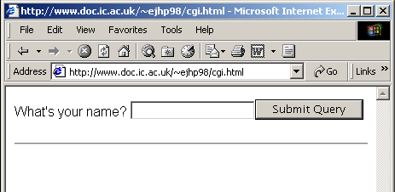

Slide 18
Guest Book Application
Task:
  Allow people to add comments to your website
Method:
  Perl script to generate HTML Form…
  …and to append comments to a text file
Disadvantages:
  Wait and see!

Slide 19
#!/usr/bin/perl
use strict;
use CGI;
my $q = new CGI;
sub print_form {
  my $q = shift(@_);
  print $q->header, $q->start_form,
  “Name: ”, $q->textfield(’name’),
  “Email: “, $q->textfield(’email’),
  “Comments: “, $q->textfield(’comments’),
  $q->submit, $q->end_form, $q->hr;
  }

Slide 20
sub append_comments {
  my $q = shift(@_);
  my $html = ‘’;
  unless (–e ‘guestbook.html’) {
  $html = $q->h1(‘Guest Book’); }
  open (FILE, ‘>>guestbook.html’) or die;
  if ($html) { print FILE $html; }
  my $email = $q->param(‘email’);
  print FILE $q->hr,
  $q->h2($q->param(‘name’)),
  $q->a({$email},$email), $q->p,
  $q->param(‘comments’);
}

Slide 21
#and finally…
if ($q->param()) {
append_comments($q);
print $q->redirect(“guestbook.html”);
}
else {
print_form($q_);
}

Slide 22
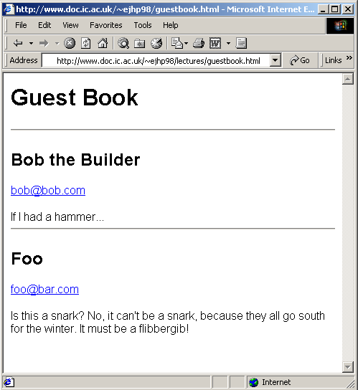

Slide 23
Disadvantages?
Oldest comments always at the top
Newest comments can appear at the top with lots of jiggery-pokery
Comments cannot be deleted without editing the file manually
No way to see all comments posted by one person, etc.

Slide 24
Solution?
Use a Database!
  Scalable
  Robust
  The One True Way!
Why? Read this book:
http://www.arsdigita.com/books/panda
And then read it again!

Slide 25
Conclusions
Perl is easy to learn
Perl is very good for text files
Text files have severe limitations
Databases are the answer

Slide 26
Next Week’s Lecture
PHP and Databases
  PHP – another programming language (very like Perl)
  mySQL – free, fast & funky relational database system
Lecture will be on Thursday 21st February (probably – check email!)

